Slide 1


Administrating SQL Server with PowerShell dbatools
Rob Sewell @sqldbawithbeard https://sqldbawithAbeard.com

Slide 2
Sponsors

Slide 3
Speaker Questionnaire
Name : Rob
Occupation : DBA, Automator, Do-er, Trainer
Interests : PowerShell, Automation And SQL (PaaS geddit?)
Interesting Fact : Beard. (Still) Plays Cricket, Flies Drone
Speaker : SQL Saturdays, SQL Relay, PowerShell Events
Community : SQL South West , SQL Sat Exeter , PowerShell VG, PowerShell Conference EU Organiser, dbareports, dbatools, SQLDiagAPI – For Consuming SQL Server Diagnostics API, MVP
Crashes

Slide 4
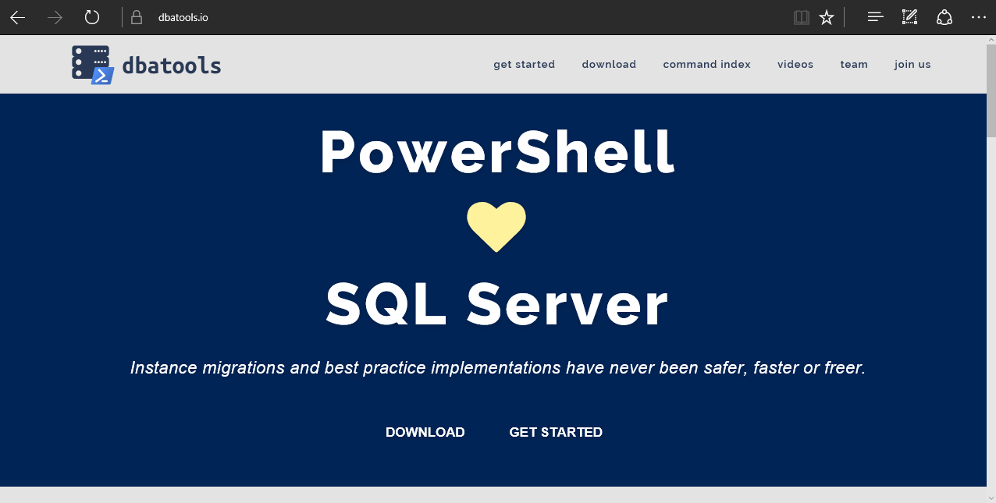
dbatools

Slide 5
requirements
Minimum
Client
PowerShell v3
SQL Server Management Studio / SMO 2008 R2
Server
SQL Server 2000
No PowerShell for pure SQL commands
PowerShell v2 for Windows commands
Remote PowerShell enabled for Windows commands
Recommended
Client
PowerShell v5.1

Slide 6
installation
PowerShell Gallery (PowerShell v5+)
Install-Module dbatools
Install-Module dbatools –Scope CurrentUser
GitHub – dbatools.io/git
Invoke-Expression (Invoke-WebRequest https://dbatools.io/in)
Clone repo found at dbatools.io/git, Import-Module dbatools

Slide 7
demos

Slide 8



Questions?
?
?
?
?
?
?
?
?
@sqldbawithbeard
robsewellsqldba
?
?
?
?
?
?
?
?
sqldbawithAbeard.com

Slide 9
More Help
Extensive documentation within each command Get-Help Start-DbaMigration –Detailed
Extensive documentation on dbatools.io
dbatools.io/Start-DbaMigration
dbatools.io/Repair-DbaOrphanUser
Some commands have videos
dbatools.io/youtube

